Slide 1
Atlanta or bust
Where to build during Atlanta’s growing housing boom

Slide 2
Atlanta is growing
Thousands moving to Atlanta, GA for jobs
Now is the time to capitalize on the demand for housing
So much space… Where do you build?
To grow fast, need to find a “prime” location

Slide 3
What is a Prime Location?

Slide 4
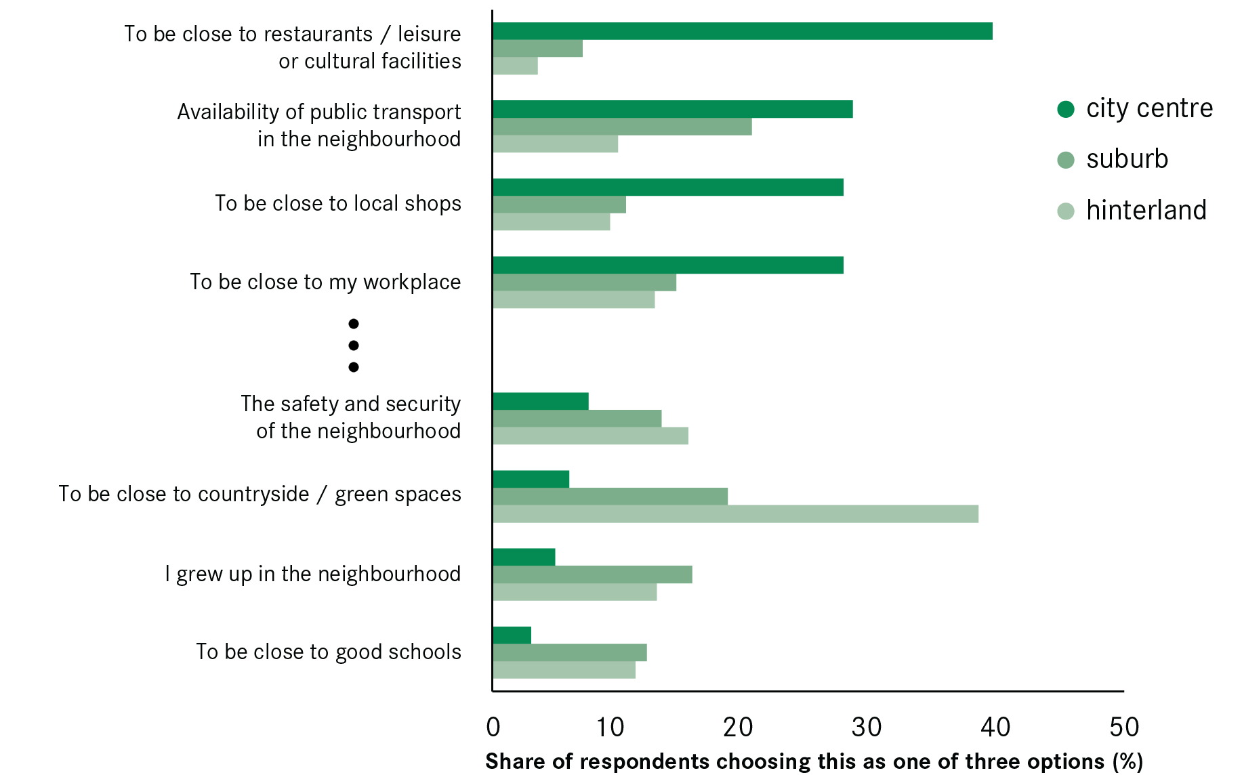
Recent Survey Results
Schools and Crime score surprisingly low
Top responses give the answer:
PROXIMITY
Source: YouGov, 2015, 1725 residents from four city regions.

Slide 5
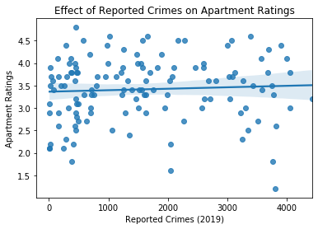
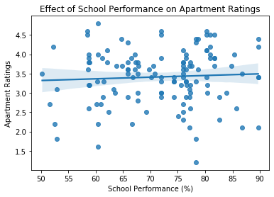
Confirming the findings
Survey data was for another city
Apartment ratings, crime, and school performance in Atlanta paint the same picture: no correlation

Slide 6

What drives up Ratings?

Slide 7
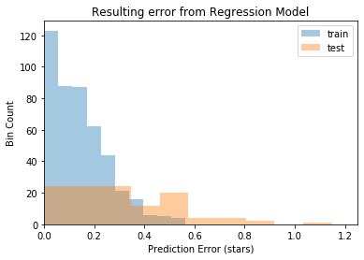
Predicting Performance
Can we predict an apartment’s rating based on these factors?
Model accurately predicts apartment ratings to within 0.5 stars on 90% of the data

Slide 8
So Where should we build?
Build where people have money
Be convenient for residents to explore their surroundings
Provide access to health and recreational facilities
Surround yourself with culture
Bring the world to your residents, and they will come to you!

Slide 9
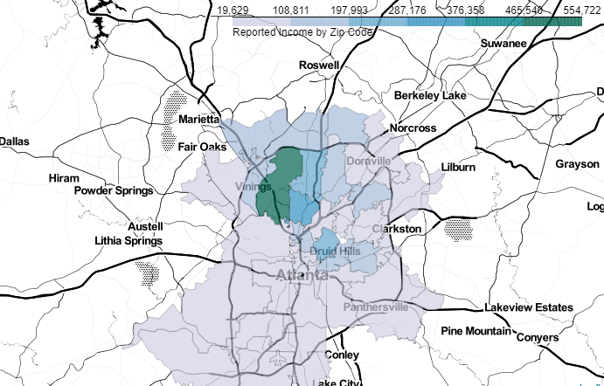
Recommendation: Northwest Atlanta
* Also has good schools and low crime as an added bonus!

